Slide 1
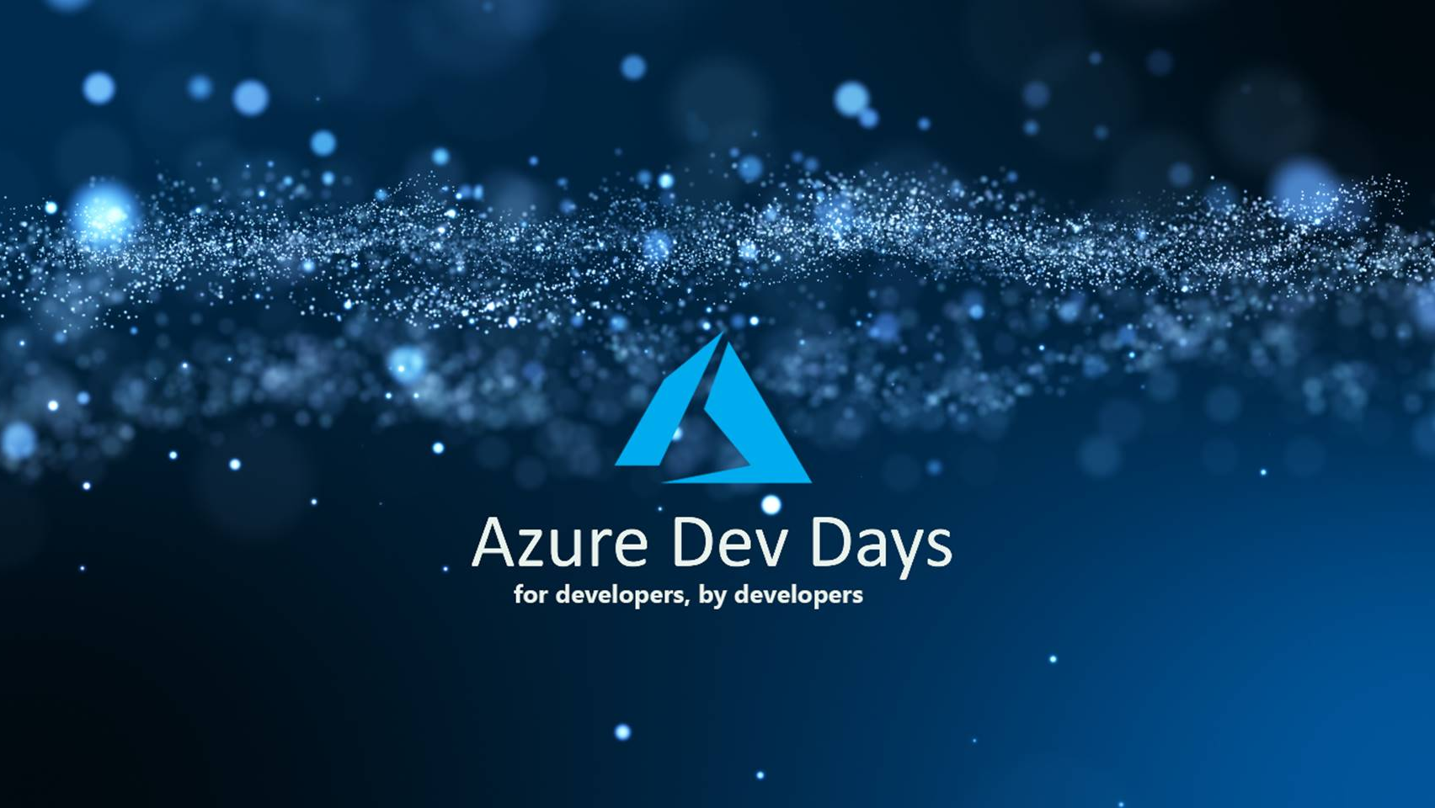


Slide 2

Hands-On-Labs

Slide 3
Common Prerequisites
Free Azure Subscription click here
Install Azure CLI click here
Install Visual Studio click here
Install VS Code click here
Install Git

Slide 4
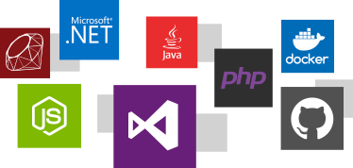
Azure App Services

Slide 5
Azure App Services
Beginner
Title
Create an ASP.NET Core web app in Azure
Azure Web Apps provides a highly scalable, self-patching web hosting service. This lab shows how to deploy your first ASP.NET Core web app to Azure Web Apps. When you're finished, you'll have a resource group that consists of an App Service plan and an Azure web app with a deployed web application.
Prerequisites
To complete this tutorial:
Install Visual Studio 2017 with the ASP.NET and web development workload.
If you've installed Visual Studio already, add the workload in Visual Studio by clicking Tools > Get Tools and Features.
Click here to start

Slide 6
Azure App Services
Intermediate
Title
Build a .NET Core and SQL Database web app in Azure App Service
App Service provides a highly scalable, self-patching web hosting service in Azure. This tutorial shows how to create a .NET Core web app and connect it to a SQL Database. When you're done, you'll have a .NET Core MVC app running in App Service.
Prerequisites
To complete this tutorial:
Install Git
Install .NET Core
Click here to start

Slide 7
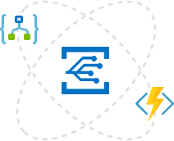
Azure Serverless

Slide 8
Azure Function
Beginner
Title
Create your first function in the Azure portal.
Azure Functions lets you execute your code in a serverless environment without having to first create a VM or publish a web application. In this lab, learn how to use Functions to create a "hello world" function in the Azure portal.
Prerequisites
None
Click here to start

Slide 9
Azure Function
Intermediate
Title
Create your first function using Visual Studio.
Azure Functions lets you execute your code in a serverless environment without having to first create a VM or publish a web application.
In this lab, you learn how to use the Visual Studio 2017 tools for Azure Functions to locally create and test a "hello world" function. You then publish the function code to Azure. These tools are available as part of the Azure development workload in Visual Studio 2017.
Prerequisites
Install Visual Studio 2017 and ensure that the Azure development workload is also installed.
Make sure you have the latest Azure Functions tools.
Click here to start

Slide 10
Azure Logic App
Beginner
Title
Create your first automated workflow with Azure Logic Apps - Azure portal
This lab introduces how to build your first automated workflow with Azure Logic Apps. In this article, you create a logic app that regularly checks a website's RSS feed for new items. If new items exist, the logic app sends an email for each item
Prerequisites
None
Click here to start

Slide 11
Azure Logic App
Intermediate
Title
Create a function that integrates with Azure Logic Apps.
This lab shows you how to use Functions with Logic Apps and Microsoft Cognitive Services on Azure to analyze sentiment from Twitter posts. An HTTP triggered function categorizes tweets as green, yellow, or red based on the sentiment score. An email is sent when poor sentiment is detected.
Prerequisites
An active Twitter account.
An Outlook.com account (for sending notifications).
This topic uses as its starting point the resources created in Create your first function from the Azure portal. If you haven't already done so, complete these steps now to create your function app.
Click here to start

Slide 12
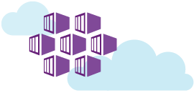
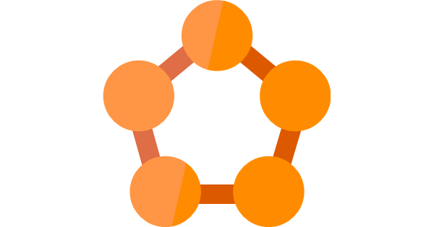
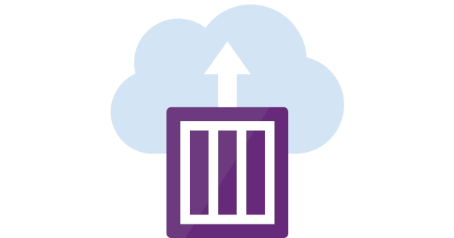
Container and Microservices

Slide 13
Azure Container Instance
Beginner
Title
Create your first container in Azure Container Instances
Azure Container Instances makes it easy to create and manage Docker containers in Azure, without having to provision virtual machines or adopt a higher-level service. In this lab, you use the Azure portal to create a container in Azure and expose it to the internet with a fully qualified domain name (FQDN).
Prerequisites
None
Click here to start

Slide 14
Azure App Service Container
Beginner
Title
Deploy a Docker/Go web app in Web App for Containers
App Service Linux provides pre-defined application stacks on Linux with support for languages such as .NET, PHP, Node.js and others. You can also use a custom Docker image to run your web app on an application stack that is not already defined in Azure. This lab shows how to create a web app and deploy a Go image from Docker Hub.
Prerequisites
None
Click here to start

Slide 15
Azure Kubernetes
Intermediate
Title
Deploy an Azure Kubernetes Service (AKS) cluster.
In this lab, you deploy an AKS cluster using the Azure portal. A multi-container application consisting of web front end and a Redis instance is then run on the cluster. Once completed, the application is accessible over the internet.
Prerequisites
None
Click here to start

Slide 16
Azure Service Fabric Mesh
Intermediate
Title
Deploy Hello World to Service Fabric Mesh
Service Fabric Mesh makes it easy to create and manage microservices applications in Azure, without having to provision virtual machines. In this lab, you will create a Hello World application in Azure and expose it to the internet.
Prerequisites
Install the Service Fabric Mesh CLI
Click here to start

Slide 17
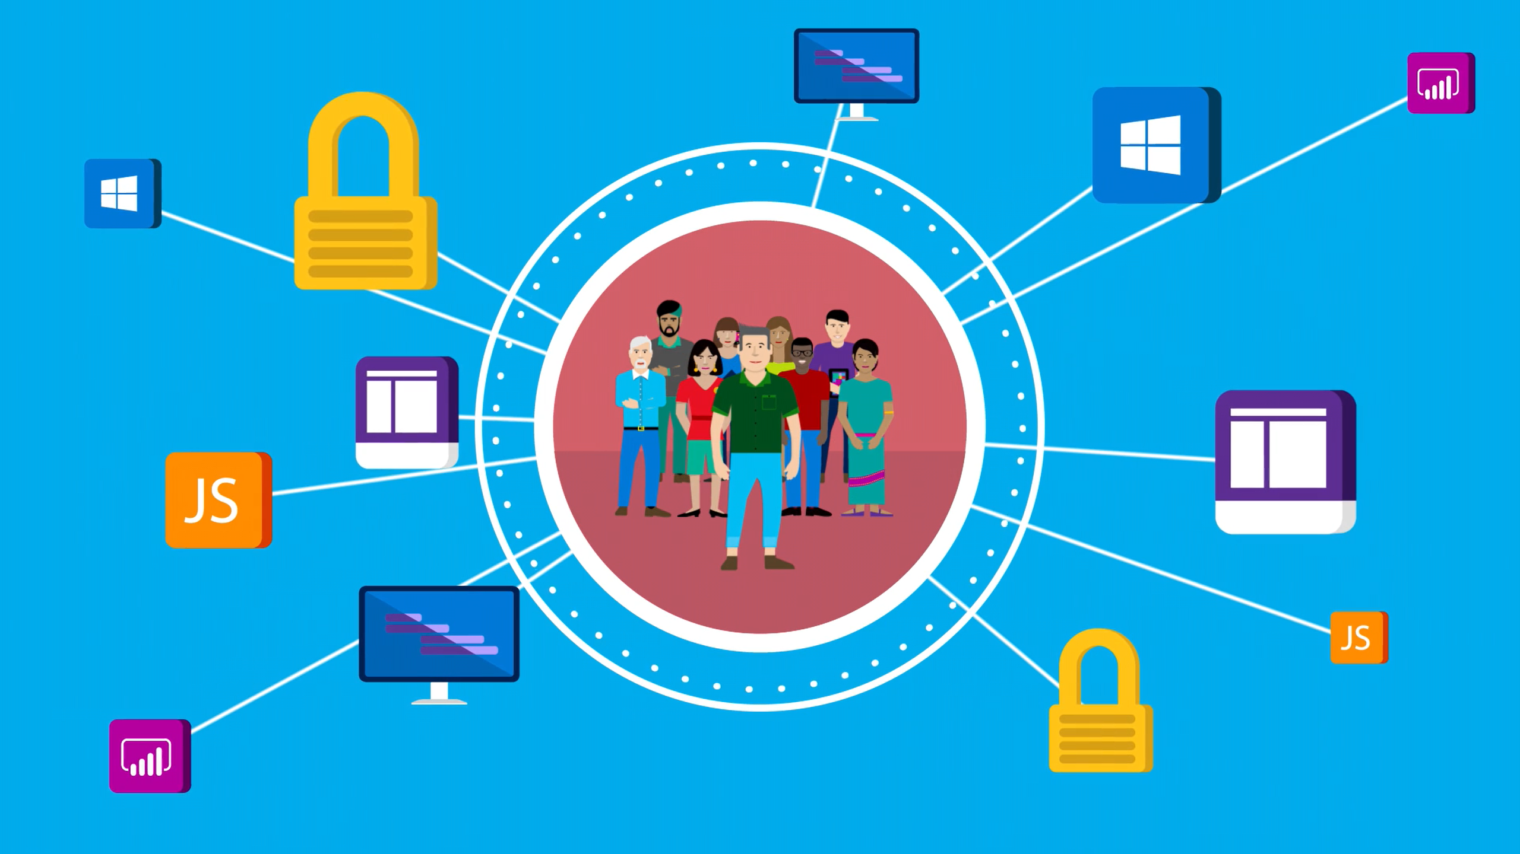
Azure DevOps

Slide 18
Azure DevOps Project .NET
Intermediate
Title
Create a CI/CD pipeline for .NET with the Azure DevOps Project
Configure continuous integration (CI) and continuous delivery (CD) for your .NET core or ASP.NET application with The Azure DevOps Project. The Azure DevOps project simplifies the initial configuration of a VSTS build and release pipeline.
Prerequisites
None
Click here to start

Slide 19
Azure DevOps Project Node.js
Intermediate
Title
Create a CI/CD pipeline for Node.js with the Azure DevOps Project.
The Azure DevOps Project presents a simplified experience which creates Azure resources and sets up a continuous integration (CI) and continuous delivery (CD) pipeline for your Node.js app in Visual Studio Team Services (VSTS), which is Microsoft's DevOps solution for Azure.
Prerequisites
None
Click here to start

Slide 20
Azure DevOps AKS
Advance
Title
Deploy your ASP.NET Core App to Azure Kubernetes Service (AKS) with the Azure DevOps Project
The Azure DevOps Project presents a simplified experience where you bring your existing code and Git repository, or choose from one of the sample applications to create a continuous integration (CI) and continuous delivery (CD) pipeline to Azure. The DevOps project automatically creates Azure resources such as AKS, creates and configures a release pipeline in VSTS that includes a build definition for CI, sets up a release definition for CD, and then creates an Azure Application Insights resource for monitoring.
Prerequisites
None
Click here to start

Slide 21
Azure DevOps Azure SfB
Advanced
Title
Deploy your ASP.NET Core App to Azure Service Fabric with the Azure DevOps Project
The Azure DevOps Project presents a simplified experience where you bring your existing code and Git repository, or choose from one of the sample applications to create a continuous integration (CI) and continuous delivery (CD) pipeline to Azure. The DevOps project automatically creates Azure resources such as Azure Service Fabric, creates and configures a release pipeline in VSTS that includes a build definition for CI, sets up a release definition for CD, and then creates an Azure Application Insights resource for monitoring.
Prerequisites
None
Click here to start

Slide 22
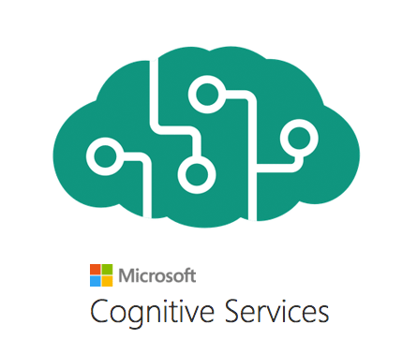
Cognitive Services

Slide 23
Q&A Bot
Beginner
Title
Create a simple Q&A bot on Azure using an FAQ page for the knowledge base.
QnA Maker enables you to power a question and answer service from your semi-structured content like FAQ documents or URLs and product manuals.
Prerequisites
None
Click here to start

Slide 24
Cognitive Search
Intermediate & Advanced
Title
Create a Cognitive Search solution for all types of business documents. The documents include pdfs, docs, ppts and images, as well as documents with multiple languages.
Cognitive Search adds data extraction, natural language processing (NLP), and image processing skills to an Azure Search indexing pipeline, making previously unsearchable or unstructured content more searchable. Information created by Cognitive Search Skills, such as entity recognition or image analysis, gets added to an index in Azure Search.
Prerequisites
None
Click here to start

